Slide 1
New COPO Tools for Brokering Single-cell & Spatial Omics Metadata
DEBBY KU & AALIYAH PROVIDENCE, DATA SCIENCE GROUP
Research Software Engineers
Notes:
Abstract: The Collaborative OPen Omics (COPO) platform now includes dedicated support for submitting metadata from Single-cell and Spatial Transcriptomics experiments. Whether you're working with Single-cell Ribonucleic Acid Sequencing (scRNA-Seq), Spatial Transcriptomics Fluorescence In Situ Hybridisation (ST-FISH) or Spatial Transcriptomics Sequencing (ST-Seq), COPO streamlines the process of structuring, validating, and submitting your metadata using established standards such as Darwin Core (DwC), Minimum Information about any (x) Sequence (MIxS) and Functional Annotation of Animal Genomes (FAANG).
This new configuration, tailored for single-cell workflows, also serves as a flexible tool that can be adapted to meet a wide range of metadata requirements across diverse omics domains. COPO does not enforce a fixed metadata model - instead, it supports user-defined metadata structures, making it easy to extend or modify worksheets, add fields and build manifests that suit your specific data submission types.
With integration to public repositories like the European Nucleotide Archive (ENA) and Zenodo, COPO helps ensure that your data is Findable, Accessible, Interoperable and Reusable (FAIR) with the scientific community.
Join this seminar to see how COPO can save you time, reduce submission errors and support your single-cell metadata submissions - while remaining fully adaptable for any other metadata needs you may have.

Slide 2
Overview
Motivation and Background
New Brokering Capabilities
Manifest Setup
Web Platform Functionality
Submission Workflow Demonstration
Future Work
Summary
‹#›

Slide 3
Motivation and Background
Collaborative OPen Omics (COPO)’s mission
Provide a platform to record collected data for a manifest
Validate submitted metadata
Broker omics data such as samples, reads, sequence annotations, assemblies
Simplify metadata and data files submission
Ensure data is Findable, Accessible, Interoperable, Reproducibility (FAIR)
Why?
Make metadata and data submission easier
Improve data sharing
‹#›
Notes:
Metadata is "data about data." It describes information like what a dataset is, who created it, when it was collected, how it was generated, and what it contains. It helps others understand, find, and use the data properly.
COPO acts as a data and metadata broker - it helps researchers organise, validate, and submit metadata according to community standards, making sure the data is well-described and ready for sharing in public repositories.

Slide 4
New Brokering Capabilities
Support for:
Single-cell RNA-Seq (scRNA-Seq)
Spatial Transcriptomics (ST-Seq, ST-FISH) (under review)
Configurable and single source of configuration
Metadata mapped to schemas for single-cell:
Darwin Core (DwC)
Minimum Information about any (x) Sequence (MIxS)
Functional Annotation of Animal Genomes (FAANG)
Tree of Life (ToL)
‹#›
Notes:
scRNA-Seq means Single-cell Ribonucleic Acid Sequencing
ST-FISH means Spatial Transcriptomics Fluorescence In Situ Hybridisation
DwC means Darwin Core
MIxS - Minimum Information about any (x) Sequence
ToL means Tree of Life (ToL)
FAANG - Functional Annotation of Animal Genomes

Slide 5
New Brokering Capabilities
Fields derived from existing data sources to reflect what’s collected in single-cell and spatial transcriptomics experiments
Validate and store any type of manifests as long as they follow the manifest setup guideline
Separate sample metadata from existing READ submission
Direct brokering to Zenodo
‹#›
Notes:
- Samples are separate and should be uploaded first
- Existing sources from which single-cell data was derived from:
- Mapping In Vivo Nascent Chromatin with EdU and Sequencing (MINCE-Seq)
- Biodiversity Cell Atlas (BCA)

Slide 6
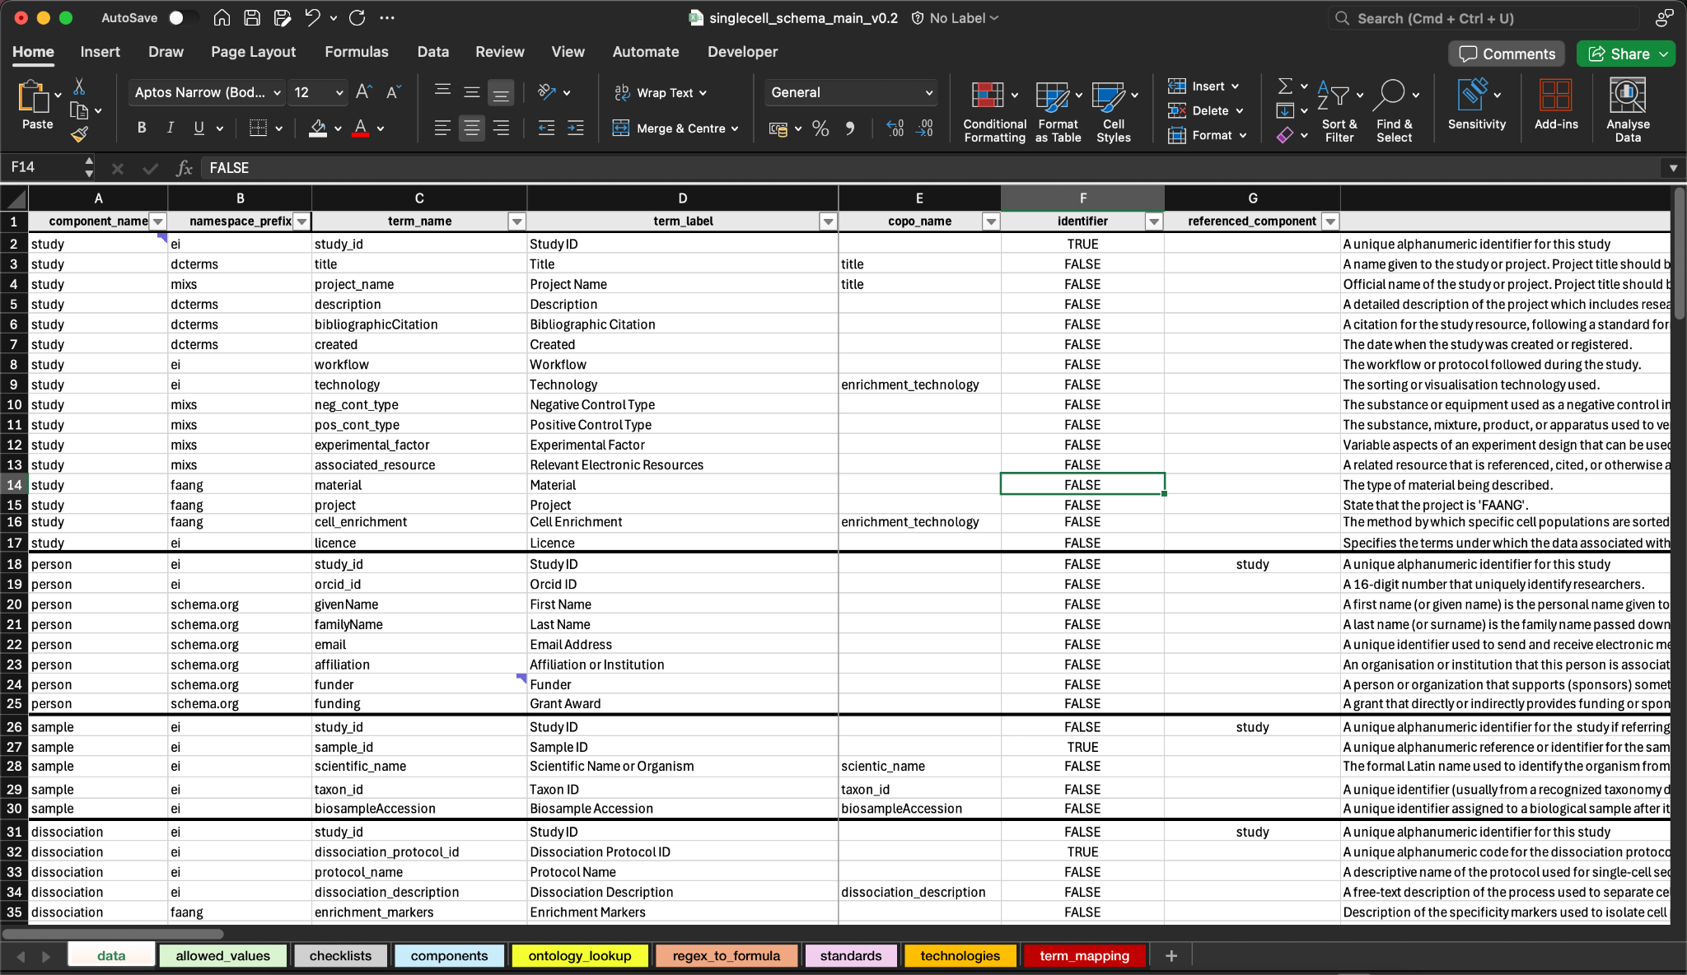
Manifest Setup
‹#›
Notes:
Main spreadsheet file where all metadata is derived like column names like term_name, namespace, description, example, regex, allowed values, type,
Sample worksheet includes minimal sample metadata such as sample ID, scientific name, taxon ID and biosample accession. All other data are in separate sample manifests.
This setup does not apply to sample manifest setup as you’ll see in the next slide.
This was done so that existing samples can be reused. Same sample can be used for different types of experiments.

Slide 7
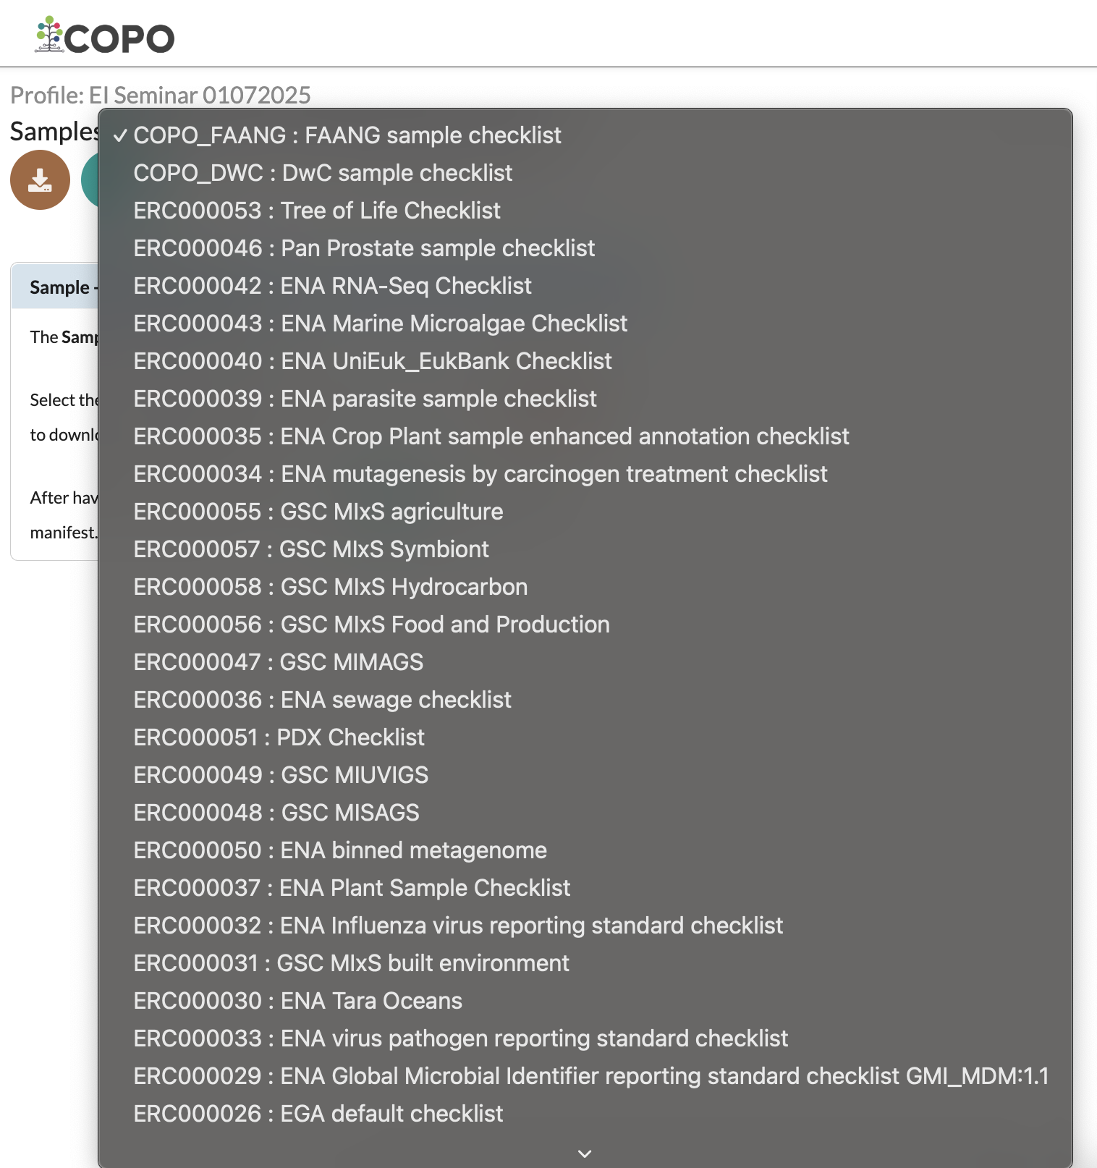
Sample manifest
ENA sample checklists
Consists mainly of MIxS standard
‹#›
Notes:
ENA sample checklists are owned by ENA. We update them daily from them.

Slide 8
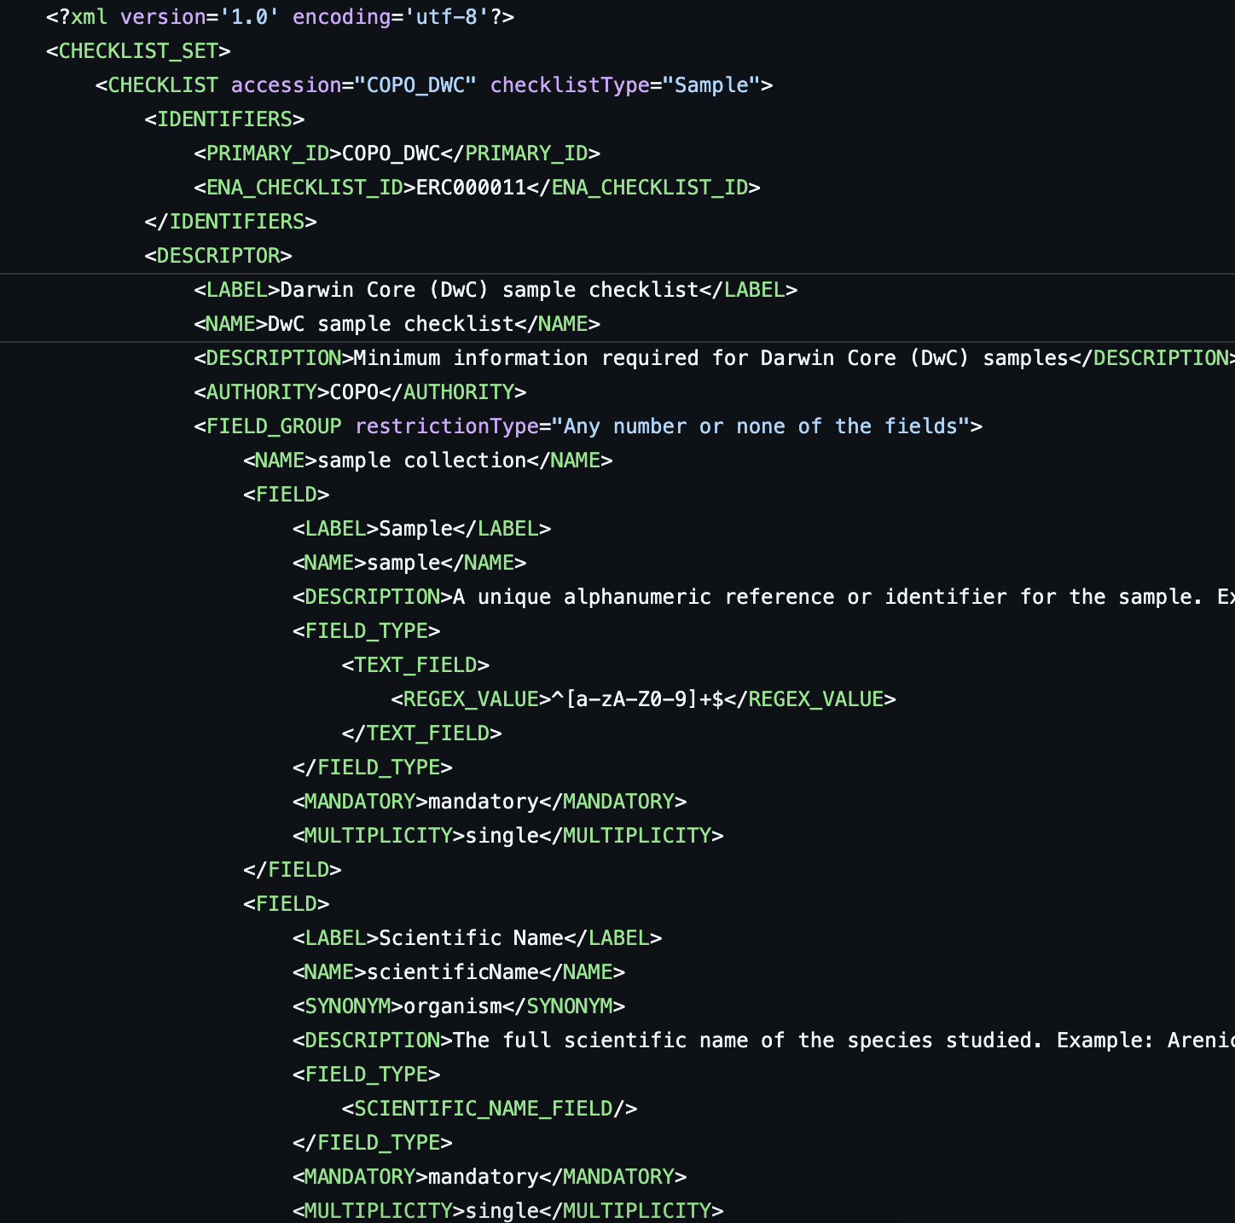
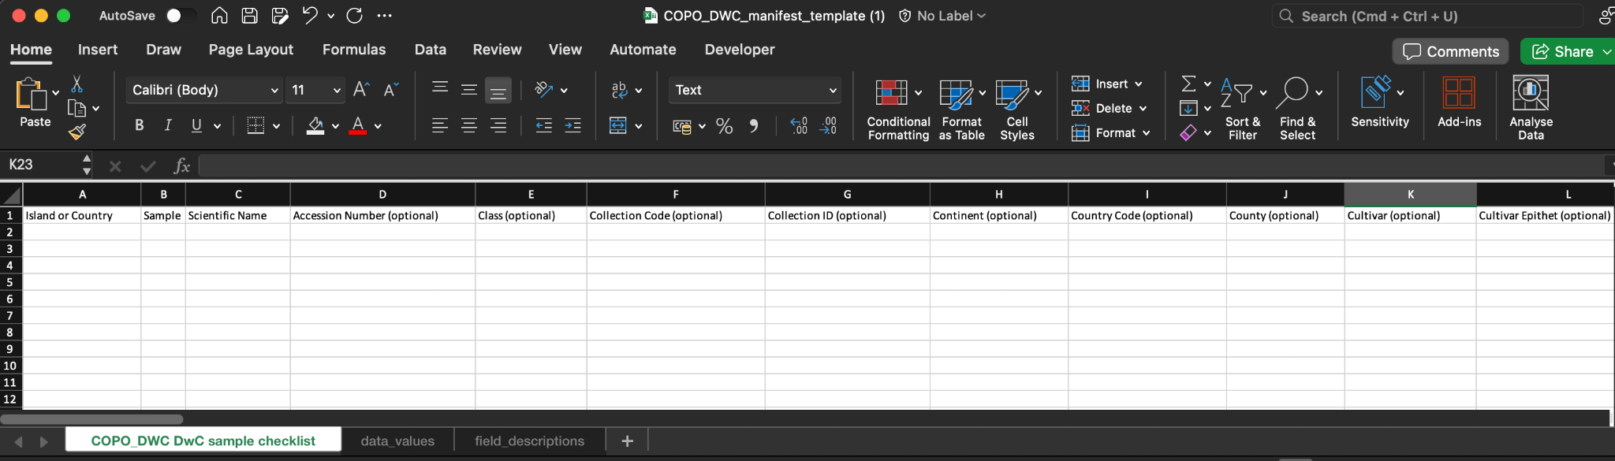
Sample manifest
DwC sample checklist
FAANG sample checklist
‹#›
Notes:
ENA default sample checklist is used for submission.
DwC and FAANG manifests are generated from .xml files. We created them therefore they can be updated when necessary. The spreadsheets are generated from them.
FAANG terms are organism, specimen collection protocol, derived from, developmental stage, animal age at collection
DwC terms are cultivar, preparations (dropdown menu; how sample was preserved), tissue (dropdown menu), scientific name

Slide 9
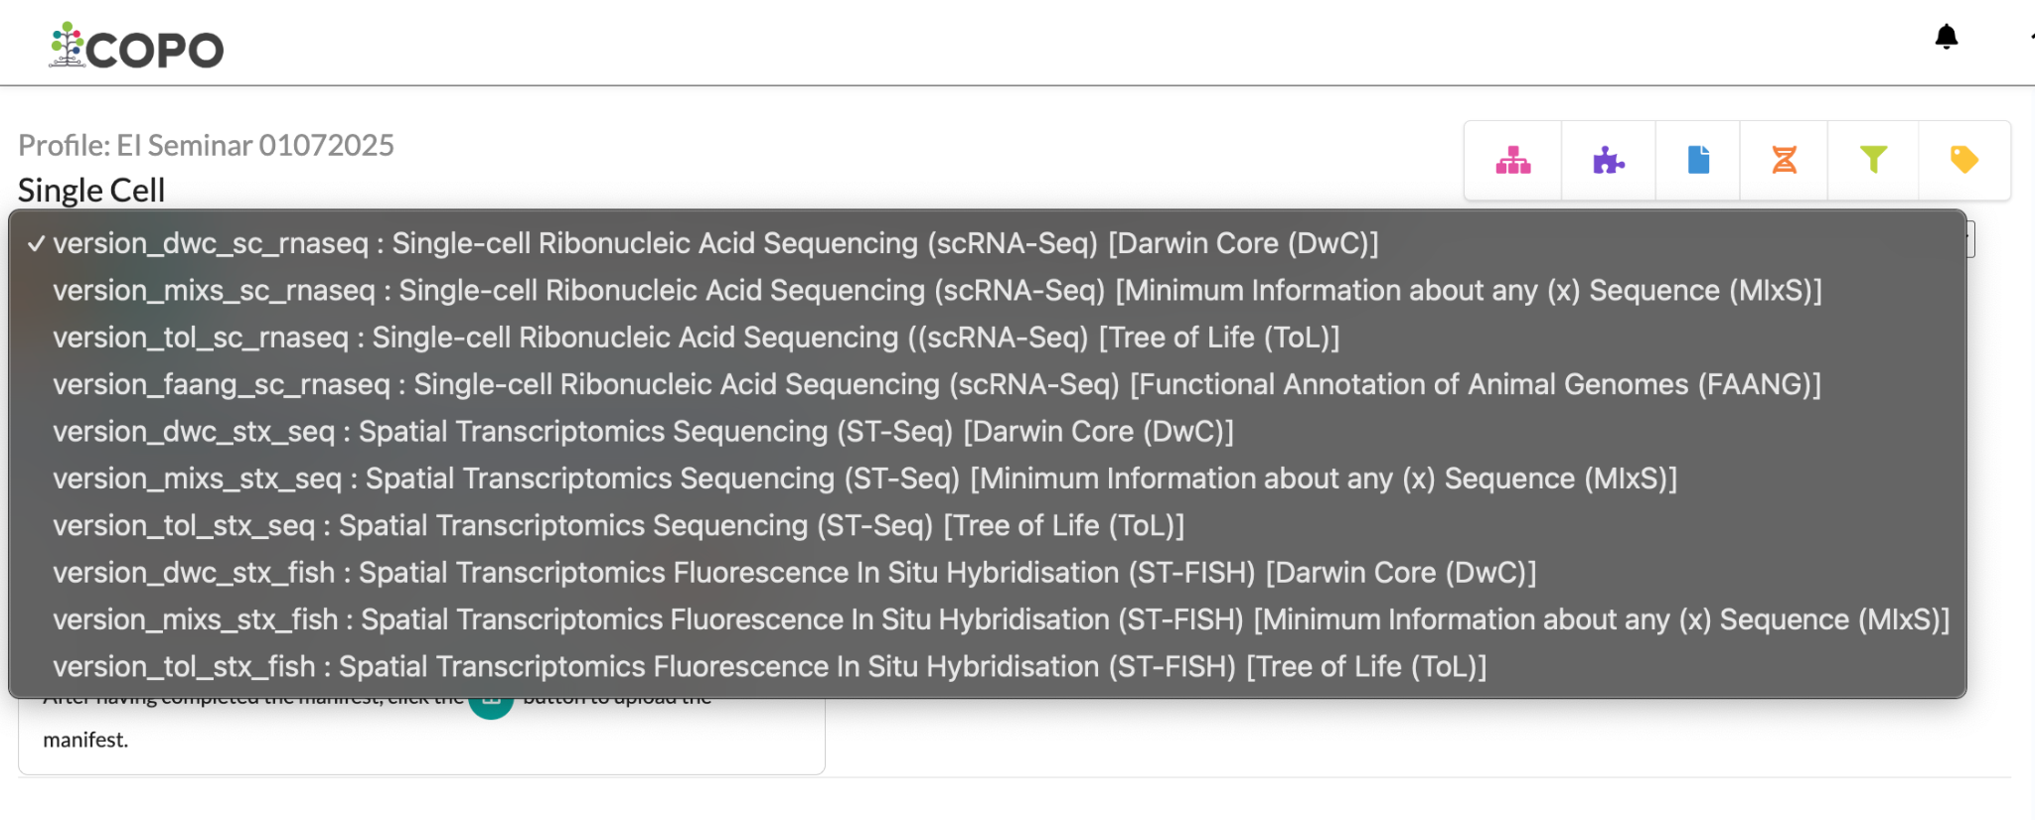
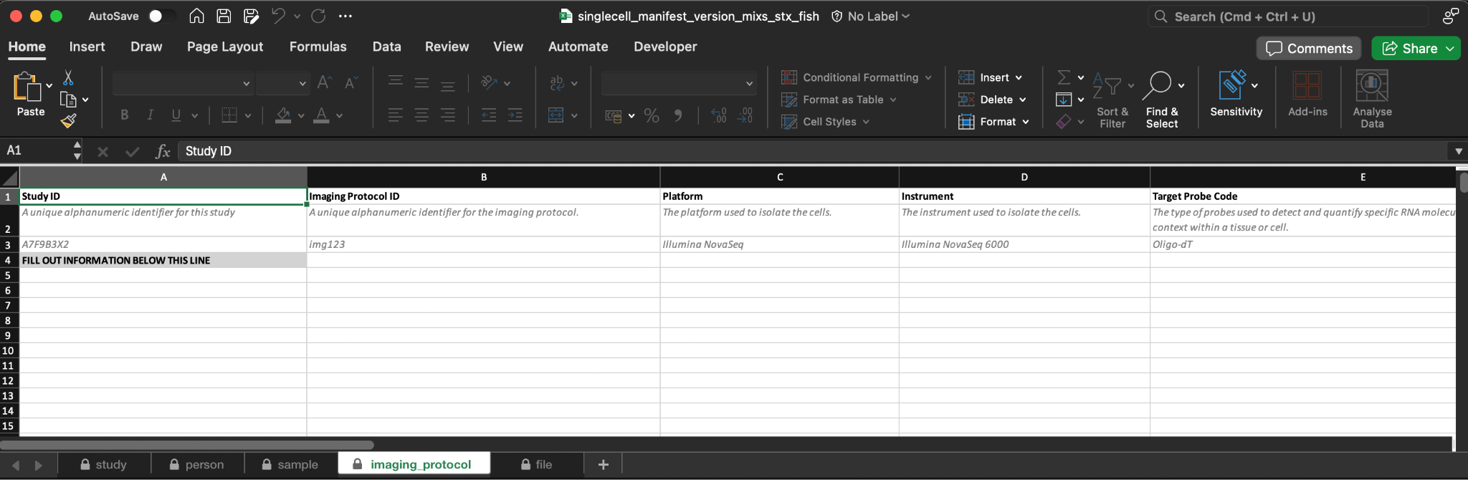
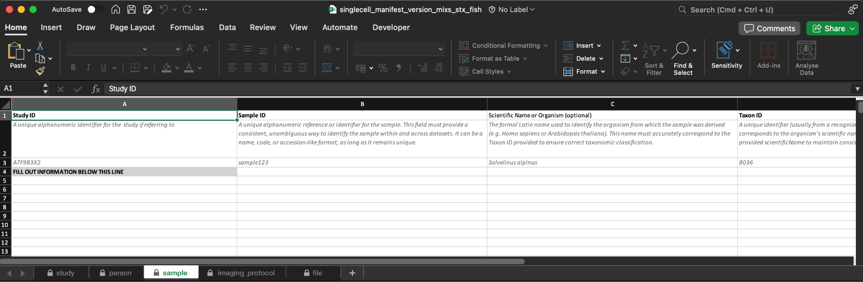
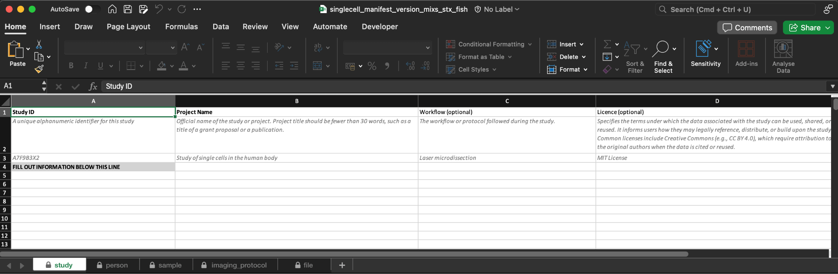
Single-cell Manifest
‹#›
Notes:
If single-cell manifest is downloaded directly from COPO, it will be prefilled sample metadata if any was submitted already in copo
If it is downloaded from the single-cell schemas website, it will be de

Slide 10
Single-cell Manifest Checklist
Technology | Darwin Core (DwC) | Minimum Information about any (x) Sequence (MIxS) | Tree of Life (ToL) | Functional Annotation of Animal Genomes (FAANG)
Single-cell Ribonucleic Acid Sequencing (scRNA-Seq) | dwc_sc_rnaseq | mixs_sc_rnaseq | tol_sc_rnaseq | faang_sc_rnaseq
Spatial Transcriptomics Sequencing (ST-Seq) | dwc_stx_seq | mixs_stx_seq | tol_stx_seq | faang_stx_seq
Spatial Transcriptomics Fluorescence In Situ Hybridisation (ST-FISH) | dwc_stx_fish | mixs_stx_fish | tol_stx_fish | faang_stx_fish
‹#›0

Slide 11
Components within Single-cell Manifest
Component | dwc_sc_rnaseq | dwc_stx_seq | dwc_stx_fish
Study | Y | Y | Y
Person | Y | Y | Y
Sample | Y | Y | Y
Dissociation | Y | - | -
Cell Suspension | Y | - | -
Library Preparation | Y | Y | -
Sequencing | Y | Y | -
‹#›

Slide 12
Components within Single-cell Manifest
Component | dwc_sc_rnaseq | dwc_stx_seq | dwc_stx_fish
Analysis Derived Data | Y | - | -
Raw Data Processing | Y | - | -
Downstream Processing | Y | - | -
Data Availability Checklist | Y | - | -
Imaging Protocol | - | - | Y
File | Y | Y | Y
‹#›

Slide 13
Person
Study
Sample
Disassociation
Sequencing
Library preparation
Cell suspension
Partial Component Hierarchy
File
Notes:
Not all components are included
Each component is connected by foreign key.

Slide 14
Component Level Submission to Public Repositories
Component | ENA | Zenodo
Study | Y | Y
File | Y | -
‹#›
Notes:
Study - is the project submitted in ENA
File - run and experiments are submitted to ENA
The whole manifest file including the data files is submitted to Zenodo.

Slide 15
Fields within Single-cell Manifest Component
Field | dwc_sc_rnaseq | mixs_sc_rnaseq | faang_sc_rnaseq
single_cell_isolation_protocol | - | - | M
workflow_hub_sop_reference | O | O | O
‹#›
Notes:
M stands for “Mandatory” O stands for “Optional”

Slide 16
General Validation for Fields
Optional or mandatory
Allowable values
File
Ontology term
Regex
Taxon ID
Scientific name
Foreign key
‹#›
Notes:
Current validation fields. We are happy to support
Foreign key connects different components together.

Slide 17



Web Platform Functionality
View data required in single-cell manifest
Download blank manifest by standard and technology
Dynamic interface updates based on selected standard/technology
https://singlecellschemas.org
https://github.com/TGAC/SingleCellSchemas
‹#›
Notes:
There will be no prefilled in the blank manifest

Slide 18
Web Platform Functionality
Search feature to filter metadata by selected options
Results displayed in accordion sections by manifest component
Each component reveals detailed field info (e.g., name, label, regex, reference, namespace)
https://singlecellschemas.org
https://github.com/TGAC/SingleCellSchemas
‹#›

Slide 19
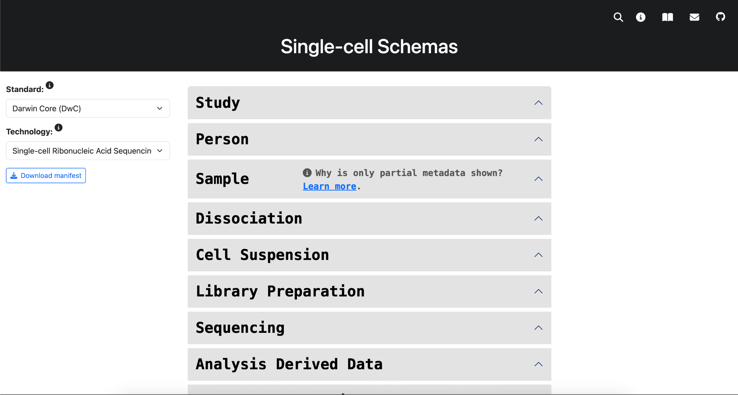

Slide 20
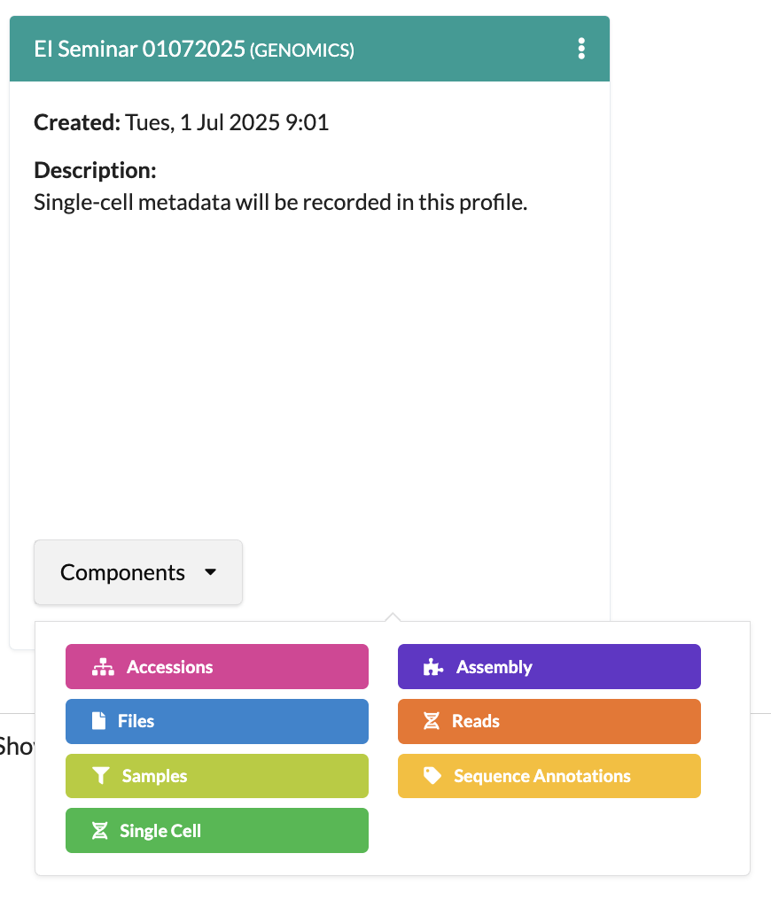
Submission Workflow Demonstration
Create profile
Upload data files via Files component
Go to Single-cell component
Download Single-cell manifest
Fill in then upload completed manifest
Check validation result
Finish the upload
‹#›
Notes:
Genomics profile must be created first before single-cell manifests can be uploaded.

Slide 21



Resources & Support
https://copo-project.org
ei.copo@earlham.ac.uk
https://copo-docs.readthedocs.io/en/latest/submissions/single-cell-submissions.html
21

Slide 22
Future Work
Extend support for REMBI image data
COPO will apply the same flexible metadata configuration used for single-cell metadata to support Recommended Metadata for Biological Images (REMBI)
Enabling structured, standards-based submission of imaging datasets
Submit image data to Zenodo and Bioimage Archive if RestAPI is ready
DOI integration for metadata snapshots
Create a DOI on demand and make a snapshot of a study at the same time, linking the metadata record with a persistent identifier.
Retrieve versioned snapshots of metadata at study level
Ensure traceability and citation of specific metadata states
‹#›

Slide 23
Summary
COPO supports Single-cell and Spatial Transcriptomics metadata submissions (e.g., scRNA-Seq, ST-FISH, ST-Seq).
Metadata submission uses recognised community standards, such as DwC, MIxS, and FAANG.
Single-cell configuration is flexible and user-driven, easy to customise metadata structures - add fields, modify components and build manifests to fit diverse data types.
COPO supports submission to public repositories like ENA and Zenodo
‹#›
Notes:
Different repositories have different submission requirements (xmls) so things like the validation, description will be different.

Slide 24

Data Science Group
European Nucleotide Archive
Felix Shaw
Joana Paupério
Irene Papatheodorou
Peter Woollard
Earlham Institute
Seanna McTaggart
Vanda Knitlhoffer
Wilfried Haerty
Ashley Lister
Tom Paine
Ian McCauley
Acknowledgements
This work is supported by the Biotechnology and Biological Sciences Research Council (BBSRC), part of UK Research and Innovation, through the Core Capability Grant BB/CCG2220/1 and Cellular Genomics (CELLGEN) Grant BBS/E/ER/230001A at the Earlham Institute.
Notes:
End of presentation

